Slide 1


PalmVision AI
A Mobile-First Computer Vision & Analytics Platform to Eliminate OER & Quality Losses in Oil Palm Harvesting

Slide 2

01 / The Industry Problem
Quantifying financial and physical losses caused by harvesting timing errors and post-harvest delays in oil palm operations.

Slide 3


Harvest Timing Losses
Oil Yield Deficit
Volume Loss & Decay
Harvesting fruit early prevents full lipid synthesis in the mesocarp.
Over-maturity causes loose fruit to fall off trees; transport delays cause oil breakdown.
Impact: Drops Oil Extraction Rate (OER) from optimal 20–23% down to 9.5–15% (a direct loss of 5.0 to 13.5 OER points).
Impact: 3–7% physical fruit loss on ground + FFA buildup at 0.1%/24 hours + 5.21% average supply chain loss.

Slide 4
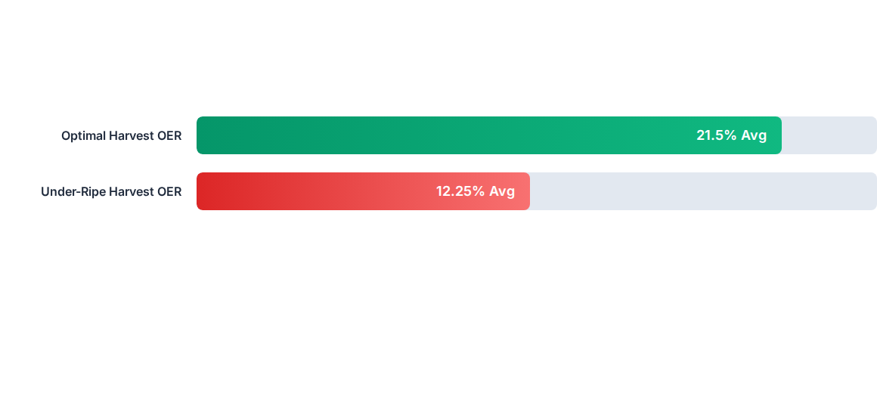
OER Drop Impact

Slide 5
Summary of Industry Losses
Harvest / Stage | Oil Extraction Rate (OER) | Volume Loss (%) | Quality Degradation | Financial Impact (MYR)
Optimal Ripeness | 20.0% – 23.0% | Baseline (0%) | Normal FFA (<2.0%) | Standard Revenue Baseline
Under-Ripe Harvest | 9.5% – 15.0% | Severe Yield Drop | Low Oil Synthesis | −5.0 to −13.5 OER points loss
Over-Ripe Harvest | Baseline Initial OER | 3.0% – 7.0% (Fruit Loss) | +0.1% FFA / 24 hrs | Loose Fruit Weight Loss
Post-Harvest Logistics | Indirect Loss | 5.21% Average Loss | Damage & Delays | MYR 0.07 – 0.12 / Ton Penalty

Slide 6
02 / Capstone AI Solution
Introducing PalmVision AI: Edge Computer Vision & Real-Time Quality Forecasting System.

Slide 7






System Architecture
1. Edge Vision AI
2. Decay Engine
3. Web Dashboard
On-device YOLOv8 model built into a mobile app. Field workers scan bunches for instant ripeness classification (Under-ripe / Optimal / Over-ripe).
Python/FastAPI backend applying a continuous mathematical decay model to track harvest timestamps and forecast accumulated FFA levels.
React dashboard for plantation managers, issuing high-priority dispatch alerts for over-ripe batches before mill penalties trigger.

Slide 8
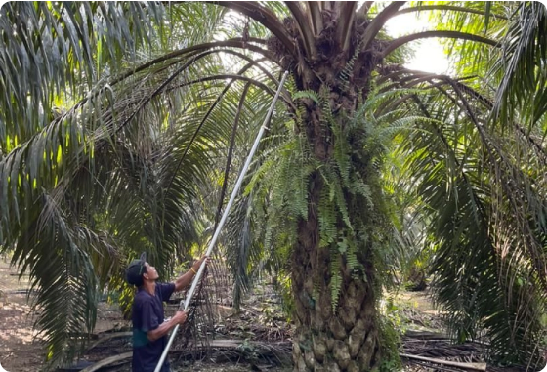

Predictive FFA Decay Logic
Mathematical Quality Tracking
Hourly Increase: 0.1% daily FFA growth translates to +0.00416% per hour.
Capstone Value: Automatically prioritize logistics to prevent fruit from exceeding quality thresholds, avoiding deductions of MYR 0.07 to 0.12 per ton.

Slide 9

Scale & Economic Value
Why Small Percentages Matter
MYR 39.1M
At CPO prices of ~MYR 4,200/tonne, an 100,000-tonne mill loses millions annually if harvesting error rates are unmonitored.
Our AI ROI: Preventing even a 2% to 3% rate of under-ripe harvesting saves individual estates hundreds of thousands of Ringgit every year.
Estimated Loss / 100k Tonnes FFB

Slide 10

Questions & Discussion
Thank you! Ready for Capstone Project Evaluation.
PalmVision AI Capstone Team
Full-Stack AI for Sustainable & Efficient Palm Oil Operations

Slide 11

Image Sources
https://cdn1.npcdn.net/images/1755078701_8d67414c8030869830a6e2056444feca.webp?md5id=103c95b905e20d63a6354e5284922bd2&new_width=1000&new_height=1000&size=max&type=3&w=1765008004&off_wm=1&from=jpeg
Source: www.guanchongagro.com

